Slide 1

Asynchronous programming in NodeJS
Antonij Djajkoski

Slide 2
The building blocks - callbacks

Slide 3
Callbacks
Callbacks are functions that are passed as an argument to another function
Shine when used in asynchronous programming, since they allow to be executed when an async task is complete
Simple syntax
Precursor to modern implementations such as Promises or RxJS Observables

Slide 4
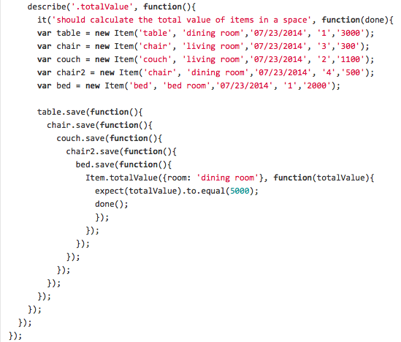
The pyramid of doom

Slide 5
Promises

Slide 6
promises
Simply, a promise that a value will (eventually) be received
Available from ES6 onwards
Callback wrappers, allow for a much more readable code
Promise states: Pending, Fulfilled, Rejected
The resolve and reject inner callbacks

Slide 7
WHy use promises?
Much cleaner code than ordinary callbacks
Simpler error handling
Chaining methods
Ability to combine multiple promises by using the static methods Promise.resolve and Promise.all

Slide 8
WHEN to use promises
Connection with database, retrieving data, inserting data...
Using the Fetch API (available for Node via the node-fetch npm library)
Various tasks that are dependent on the execution of another task beforehand

Slide 9
ASYNC AWAIT

Slide 10
ASYNC AWAIT
Syntactic sugar wrapper over promises
Further simplification of writing async code
Used by declaring a function async
This allows the await keyword to be used within the function
Await freezes the rest of the function execution until a value is received

Slide 11
Extra materials
https://developer.mozilla.org/en-US/docs/Web/JavaScript/Reference/Global_Objects/Promise
https://medium.com/javascript-everyday/javascript-theory-promise-vs-observable-d3087bc1239a

Slide 12

THANK YOU!

